Slide 1
Module 4
Functions

Slide 2
Announcements

Slide 3
Attendance
bit.ly/attend8

Slide 4
Comparing Histograms

Slide 5
Overlaid Graphs
For visually comparing two populations
(Demo)

Slide 6
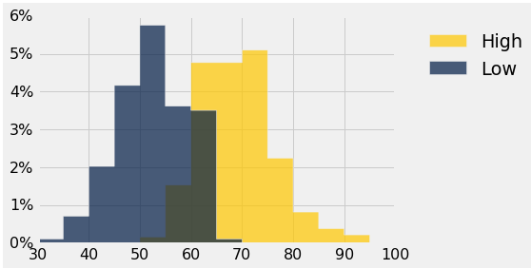
Discussion Question
This histogram describes a year of daily temperatures
Try to answer these questions:
What proportion of days had a high temp in the range 60-69?
What proportion had a low of 45 or more?
How many days had a difference of more than 20 degrees between their high & low temperatures?

Slide 7
Defining Functions

Slide 8
Def Statements
User-defined functions give names to blocks of code
Name
Argument names (parameters)
def spread(values):
return max(values) - min(values)
Return expression
Body
(Demo)

Slide 9
Discussion Question
What does this function do? What kind of input does it take? What output will it give? What's a reasonable name?
def f(s):
return np.round(s / sum(s) * 100, 2)
(Demo)

Slide 10
Apply

Slide 11
Apply
The apply method creates an array by calling a function on every element in input column(s)
First argument: Function to apply
Other arguments: The input column(s)
table_name.apply(function_name, 'column_label')
(Demo)

Slide 12
Example: Prediction

Slide 13
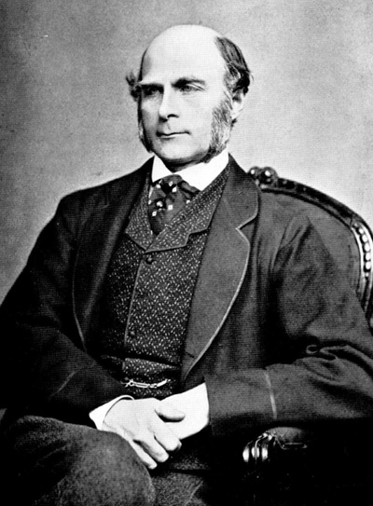
Sir Francis Galton
1822 - 1911 (knighted in 1909)
A pioneer in making predictions
Particular interest in heredity
Charles Darwin's half-cousin
(Demo)

